Slide 1


Slide 2
Table of Contents
INTRODUCTION
1.1. Introduction to the Project
1.2. Business Requirements
DATA SOURCE
2.1. List of S&P 500 companies (Wikipedia)
2.2. S&P 500 Stocks (Kaggle)
2.3. S&P 500 Companies with Financial Information (DataHub)

Slide 3
Table of Contents
DATA MODELLING
3.1. Why? “Why you choose specific schema (star schema,… etc.) ”
3.2. Model
LOGICAL DATA MAPPING
Queries
Visualization
Insights
Conclusion

Slide 4
INTRODUCTION
Introduction to the Project
The S&P 500® is widely regarded as the best single gauge of large-cap U.S. equities. According to our Annual Survey of Assets, an estimated USD 13.5 trillion is indexed or benchmarked to the index, with indexed assets comprising approximately USD 5.4 trillion of this total (as of Dec. 31, 2020). The index includes 500 leading companies and covers approximately 80% of available market capitalization

Slide 5
Business Requirements
This project seeks to analyze the data of the S&P 500 stock market and its
firms using a variety of KPIs in order to derive insights that could aid
investors in better understanding the market and identifying profitable
investment opportunities.
Analysis of stocks will be useful for new investors to invest in stock market based on the various KPIs like Market capitalization, earning per share, and stock price etc. considered by dashboards

Slide 6
DATA SOURCE
List of S&P 500 companies (Wikipedia)
Link:
Date of creation: Unknown.
Descriptions:
The data source comprises 503 common stocks which are issued by 500 large-cap companies traded on American stock
exchanges (including the 30 companies that compose the Dow Jones Industrial Average).
The data shows the symbol, sector, sub-industry, Date first added.
ETL:
The data was extracted using https://wikitable2csv.ggor.de/ website and saved as a CSV file.
No transformation was required.

Slide 7
S&P 500 Stocks (Kaggle)
Link:
Date of creation: Unknown.
Description:
The data consists of 3 tables (sp500_companies.csv, sp500_index.csv, sp500_stocks.csv).
The data is daily updated from 2009 till now.
ETL:
The data was downloaded as a CSV file.
No transformation was required

Slide 8
S&P 500 Companies with Financial Information (Data Hub)
Link:
Date of creation: 4 years ago.
Description:
List of companies in the S&P 500 (Standard and Poor’s 500). The S&P 500 is a free-float, capitalization-weighted index of the top 500 publicly listed stocks in the US (top 500 by market cap). The dataset includes a list of all the stocks contained therein and associated key financials such as price, market capitalization, earnings, price/earnings ratio, price to book etc.
Notes: Market Capitalization and EBIDTA are in Billions.
ETL:
The data was downloaded as a CSV file.
No transformation was required.

Slide 9
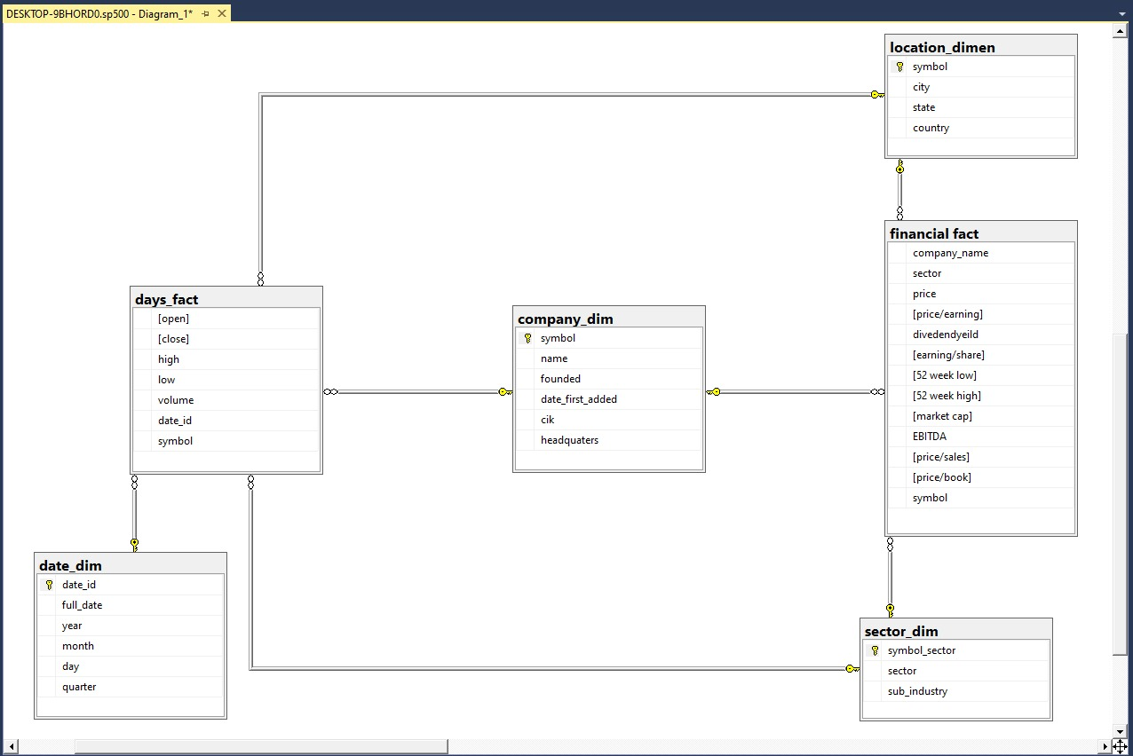
DATA MODELLING
I chosed "Galaxy schema" because we have two fact tables linked to four dimensions tables with different granularity levels days_fact (daily) but financial_fact (yearly).

Slide 10
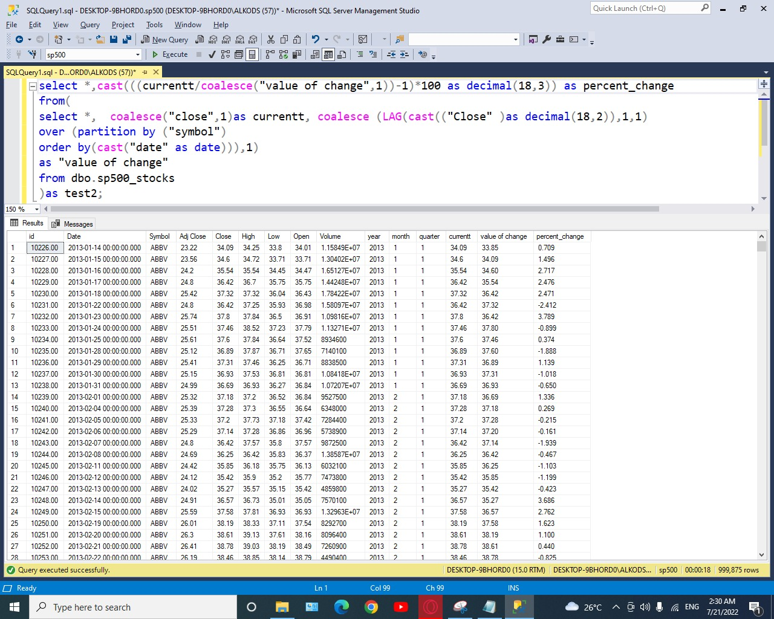
Queries
To show change in share price over years; if it was positive, share price will increase
Elseif
it was negative, share price will decrease.

Slide 11
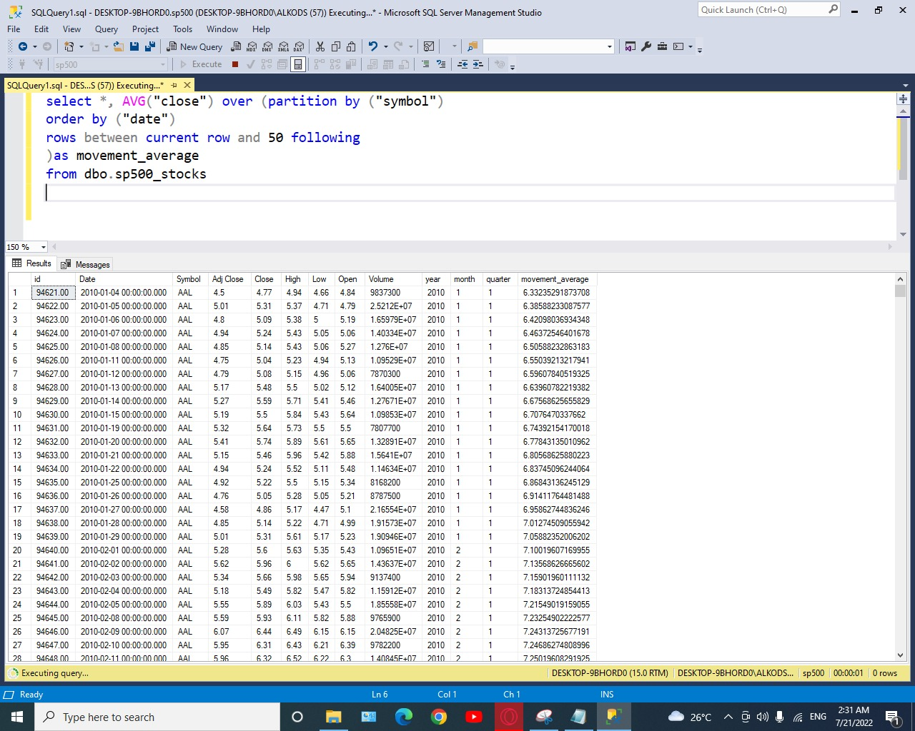
Important analytical tool used to identify current price trends and the potential for a change in an established trend.

Slide 12
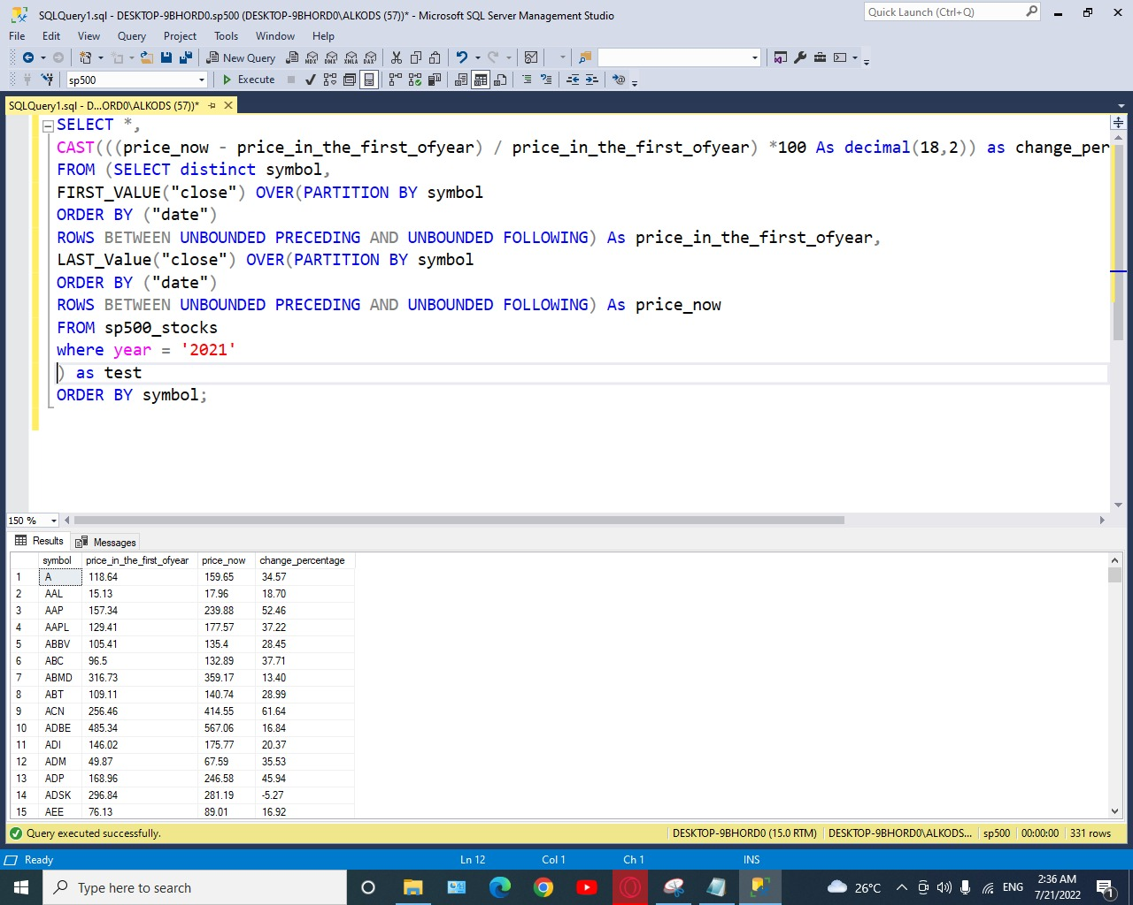
Shows us the change in 2021 of the Stock market for every company.

Slide 13
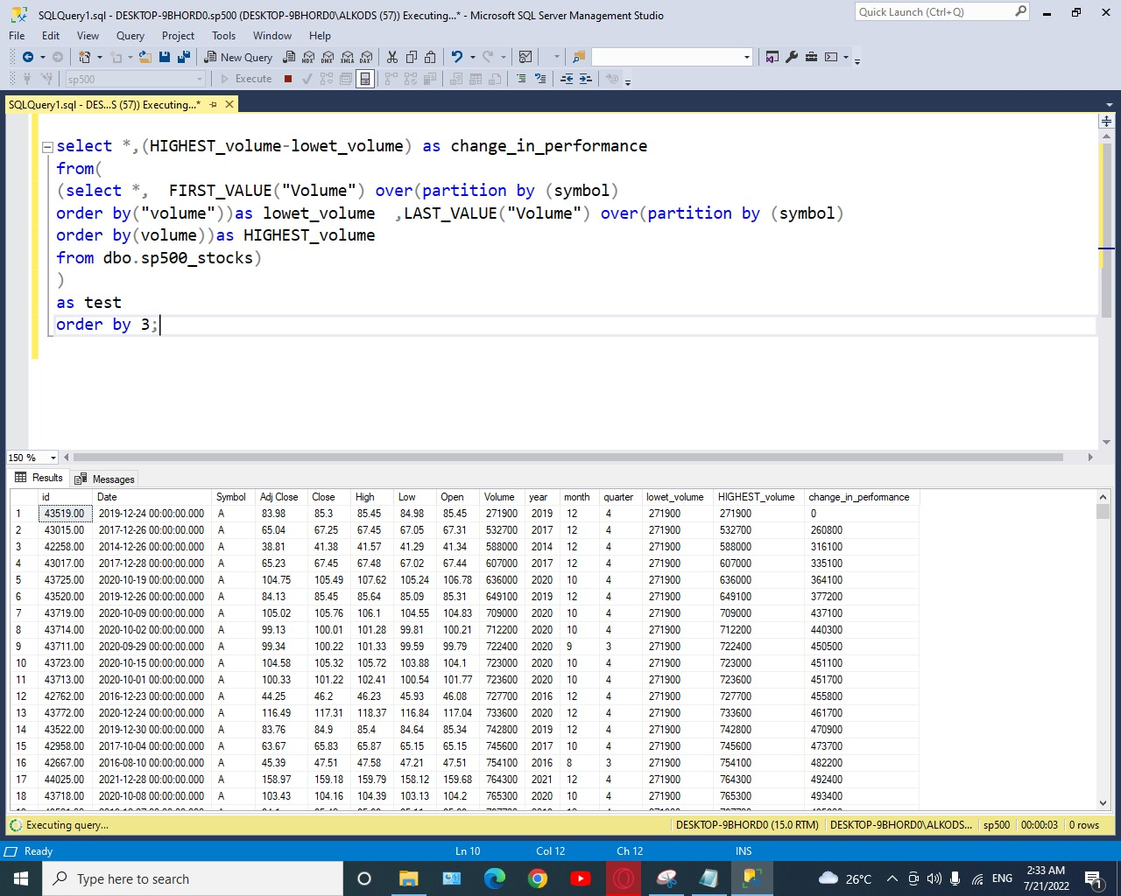
Shows us the change of performance for companies per years.

Slide 14
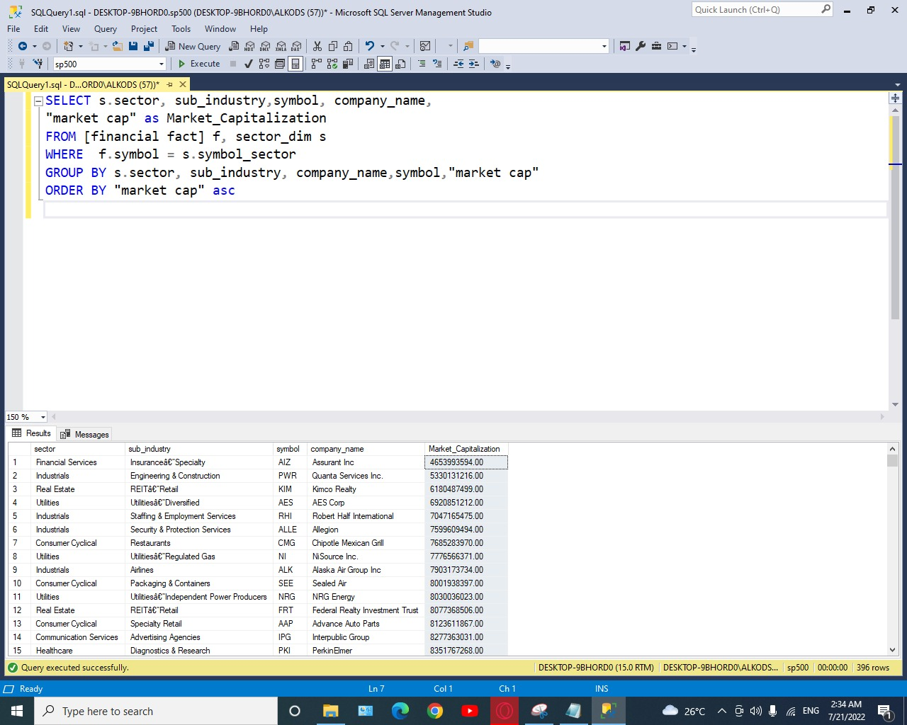
Shows us the sector and sub industry for the highest and lowest companies in the market capitalization.

Slide 15
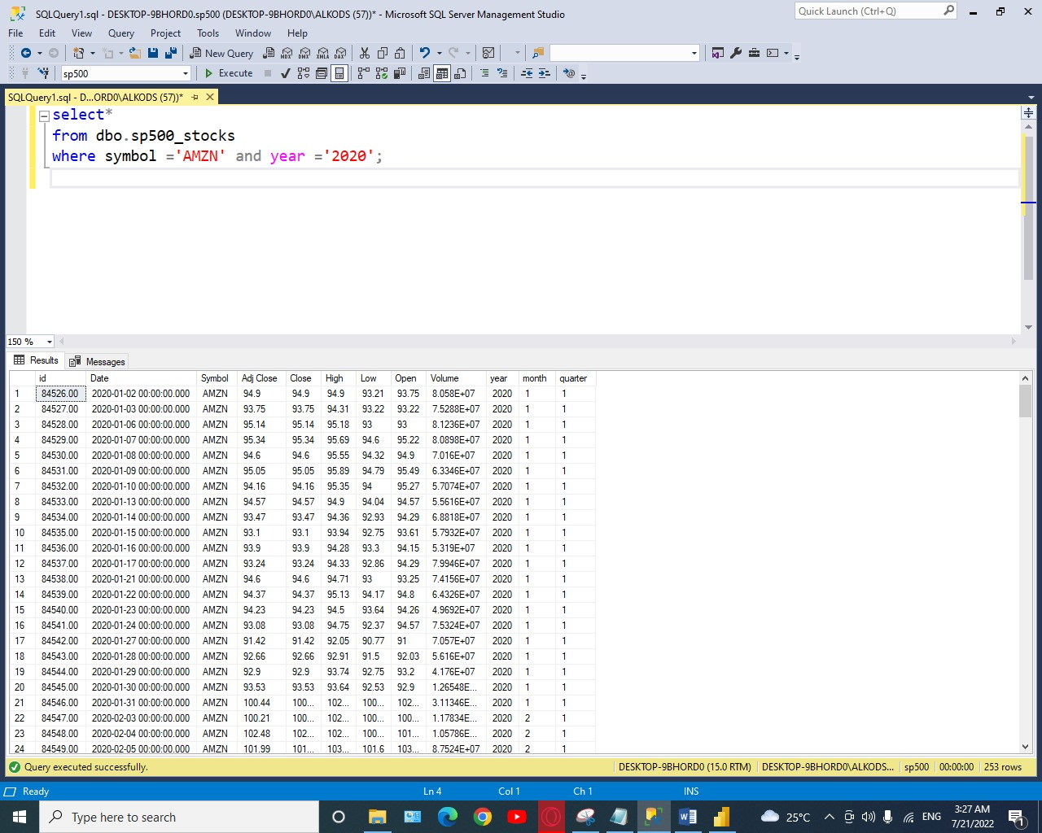
Amazon event in 2020.

Slide 16
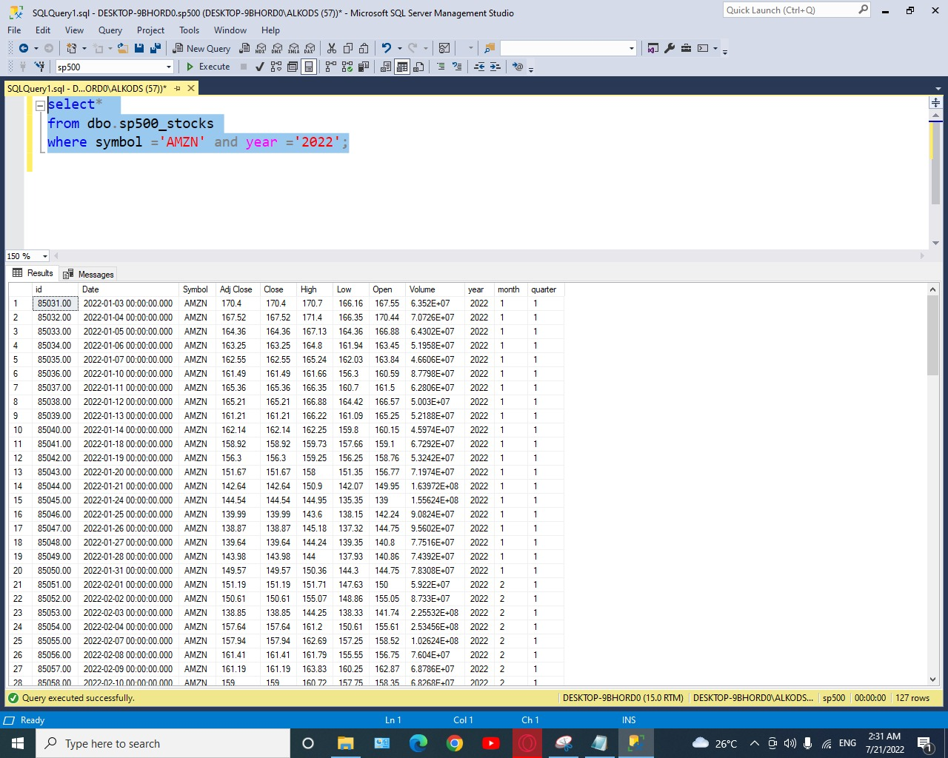
Amazon event in 2022.

Slide 17
Visualization in Power BI

Slide 18
Thank you

